Slide 1
THE OPEN DOOR
November 2022
Moderator Letter (Lisa Morehead)
This is the month for giving Thanks. We have a new interim pastor coming in. Pastor Susan will give her first sermon on November 20th, the beginning of Thanksgiving week. We give thanks for her. We give thanks for the start of a new chapter of our church. We give thanks for the pies we were able to complete. We give thanks for our children attending Sunday School. We give thanks for Adult Bible School. We give thanks for our 200th year celebration. We give thanks to our senior group. We give thanks to all our church members who have kept us going. The most important thanks is to God, through his grace we continue.
I give Thanks to all of you. Whether it is a kind word or hug, I am continually amazed at what wonderful people surround me. Thank you All.
1 Thessalonians 5:16-18 – Rejoice always, pray without ceasing, in everything give thanks, for this is the will of God in Christ Jesus for you.
A note from Cyndi, please remember to give thanks to Lisa for all she has done (and still has to do) and keep her in your prayers.

Slide 2
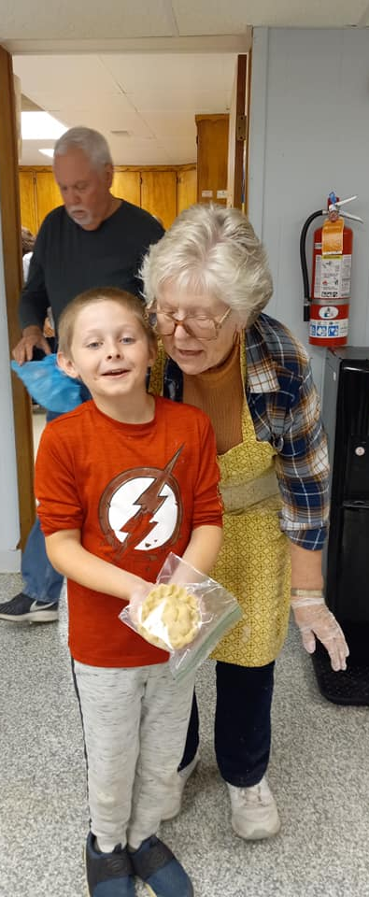
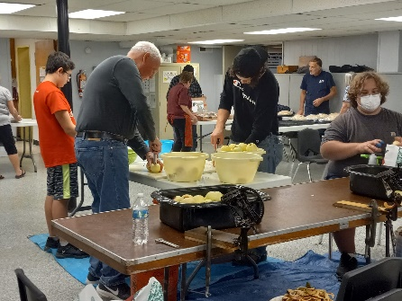
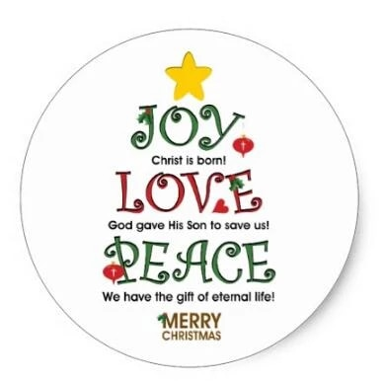
Thank you to all those that came out to help with apple Pies!!! November 2nd will be out last week making them so there is still time to help.
Christmas decorating meeting, November 6th after Church services (come with ideas)!!
Theme: Joy, Peace and Love
(We will be decorating November 26th)
Pastor Susan will be giving her first sermon on Sunday, November 20, we will be having a Brunch after services to welcome her to the Church, all are invited.
We are going to be using one call to let people know about deaths and other information within the Church. If you would like to be added please email Cyndi at EUCnews1823@gmail.com or fill out the connect card at Church.
We are also doing a member directory for 2023, we need up-to-date information. If you have not done so, please up-date on the connect card or email Cyndi.

Slide 3
Senior Funday
Wednesday, November 2nd , from 11:30 to 2:00,
(1st Wednesday of the month)
All are welcome
The 200th Year Celebration - Going thru our History, articles and photos. Next meeting Tuesday, November 22nd from 10-noon. Contact Jeneen Kubala at 330 687-4067 if you have any questions or would like to help.
We will be having Youth Group for any kids from
5th-12th grade on November 13th from 4-6 at the Church.
Anyone that is interested may attend.
Youth Group will be every 2nd Sunday of the month.
Sunday School after Sunday services until 10:30, for kids ages preschool-5th graders.
Adult Sunday School after Sunday services.
For anyone interested in getting on our breeze site, go to edinburg.breezechms.com. Just follow the directions to set up your account. You can use this to up-date any of your information, give online, etc.
Scouts Spaghetti dinner, Saturday, November 5th 4-7 p.m. If anyone is interested see Sabrina, Matt or Cyndi for tickets

Slide 4
NOVEMBER 2022
SUN | MON | TUES | WED | THURS | FRI | SAT
 |  | 1 | 2 | 3 | 4 | 5
6 | 7 | 8 | 9 | 10 | 11 | 12
13 | 14 | 15 | 16 | 17 | 18 | 19
20 | 21 | 22 | 23 | 24 | 25 | 26
27 | 28 | 29 | 30
Jace Simmons
Kim Bradley
Jennifer Mix
Davinda Baldasare
Damian Dech
Debbie Phile
Veteran’s Day
Cindy Stuart
Nicole & Lenny
Reiter
Arlene Shambach
Donn Bell
Jenna Phile
Cathy Thomas
Ryan Zimmerman
Fran Pruchenski
Adain Campbell
Thanksgiving Day
Lin Dennis
Rick Mann
Kevin Kibler
Mary & Duane
Kaley
Travis Brown
Genny & George Pavlick
Tina Finney
Nicole Reiter
Cookie Queens and Kings are needed to bring cookies on Sundays. To sign up get ahold of Lisa Morehead.
Cookie queens for Nov. are:
Nov. 6th Julia Hayes
Nov. 13th Diane Ringer
Nov. 20th Maureen Locher
Nov. 27th Ramona Holloway
marialisamorehead@gmail.com
(330-247-8171)
NEW Email for Lisa
Future Council Dates:
November 10th
December 8th
Have you, your kids, grandkids or anyone else done something you would like to announce??? If you would like anything added to the newsletter, please let Cyndi know before the last Saturday of the month.
NEW EMAIL: EUCNEWS1823@gmail.com

